Slide 1
DATA WAREHOUSE: FLIGHT DELAY
BY:
RAJAT JAIN-2019SP93039
SAMPATTI DINESH METKAR-2019SP93037
VARSHAA SHREE-2019SP93065

Slide 2
SCOPE
TO ANALYSE AND VISUALISE THE CAUSE FLIGHT DELAYS FROM YEAR 2015-2019 FOR THE COUNTRY OF USA
GRANULARITY: MONTH LEVEL,LOCATION LEVEL
PRESENTATION LAYER: Flight Delay Analysis based on cause , location and time.
What we intended to show the user?
To get an understanding of cause of delay in terms of year and location.

Slide 3
CHARACTERSTICS OF DATAWARE HOUSE WE HAVE USED:
TIME VARIANT: WE HAVE USED AND ANALYSED DATA FROM THE PROVIDED FLIGHT DELAY DATASET BASED ON DIMESION TIME YEAR 2015-2019
SUBJECT ORIENTED: OUR DATA WAREHOUSE DESIGN MAINLY IS AROUND THE TOPIC OF CAUSE OF FLIGHT DELAY AND INTER RELATIONS OF DIMENSIONS SUCH AS LOCATION AND TIME ON THE CAUSE OF DELAY
DATA INTEGRATED : WE HAVE USED MULTIPLE DATA FROM DIFFERENT SOURCES SUCH AS AIRPORT,AIRLINE AND SPECIFIC DELAY RELATED DATA. THESE DATA WERE USED AFTER REMOVING INCONSISTENCIES THROUGH ETL PROCESSING
NON-VOLATILE: WE HAVE NOT ADDED THE CAPABILITY FOR THE DATA WAREHOUSE TO GROW WITH TIME AND HAVE USED STATIC DATA THIS JUSTIFES NON-VOLATILE BUT TO MAKE IT WORK IN FUTURE FOR UPDATIONS ON THE EXISTING

Slide 4
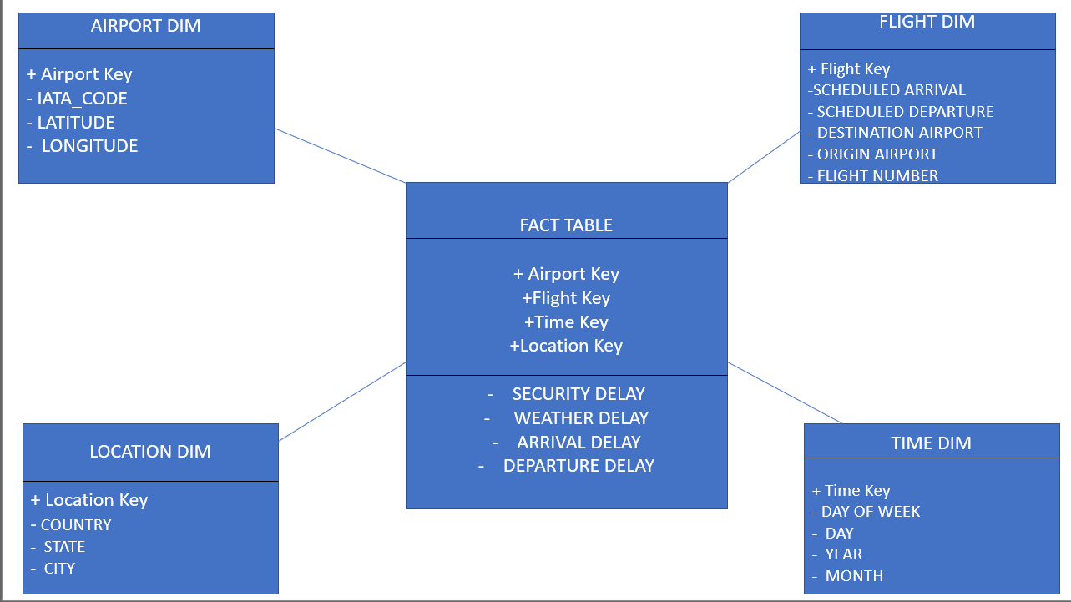
SCHEMA USED:

Slide 5
DATA WAREHOUSE ARCHITECTURE-CENTRALISED DATA MART
Why?
We are using data touching areas which are stored within the data warehouse and not enterprise level.
ALL THE TABLES AIRPORT,TIME,LOCATION LEVEL ARE ALL STORED WITHIN THE DATA WAREHOUSE HENCE MAKING IT CENTRALISED.

Slide 6
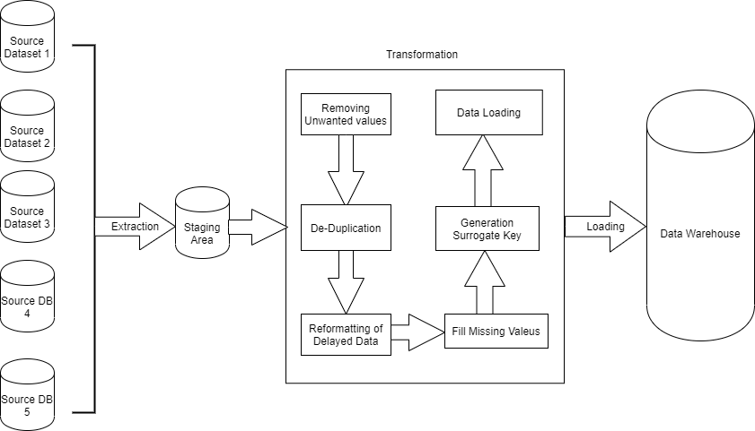
Extract Transformation Loading

Slide 7
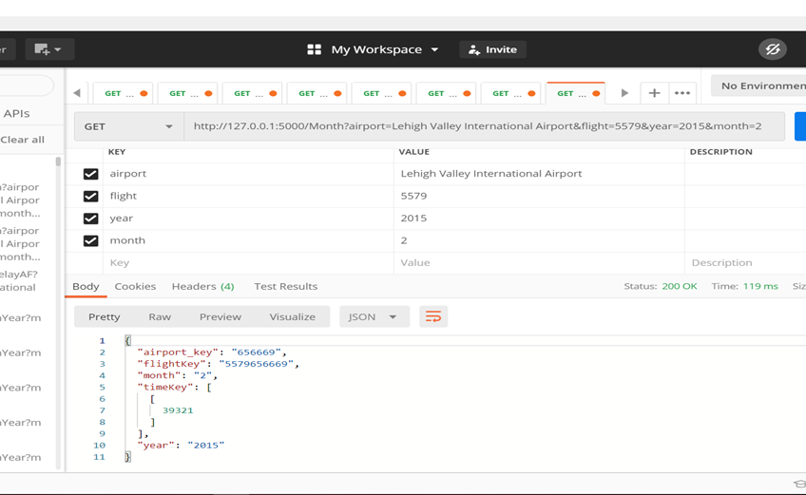
API CALLS

Slide 8
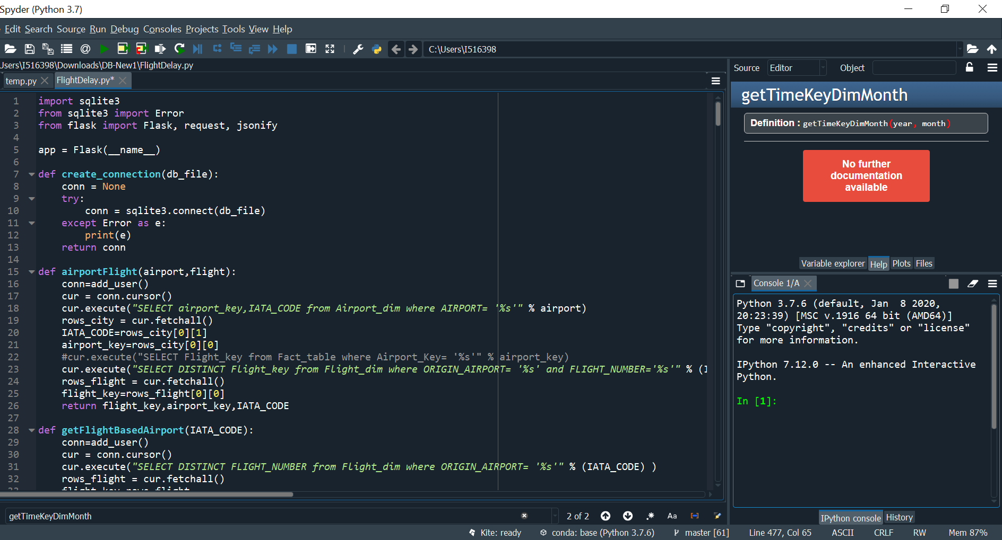

Slide 9
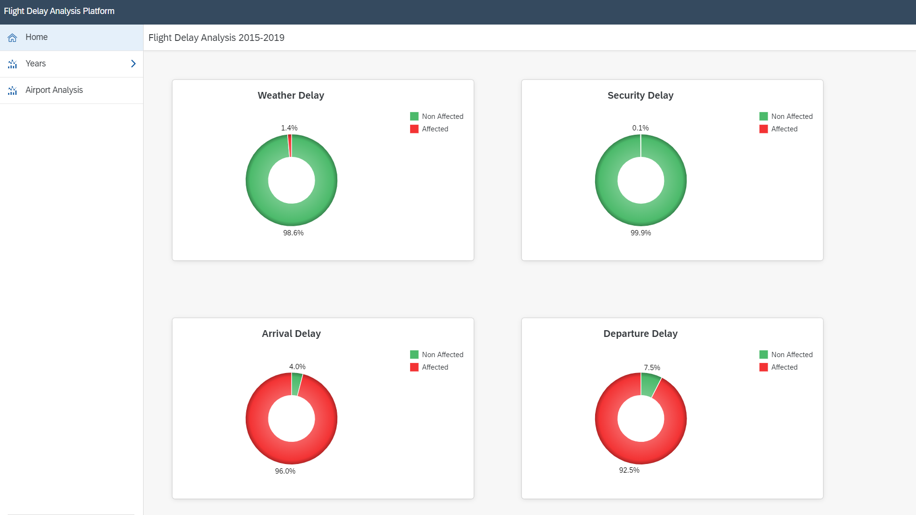

Slide 10
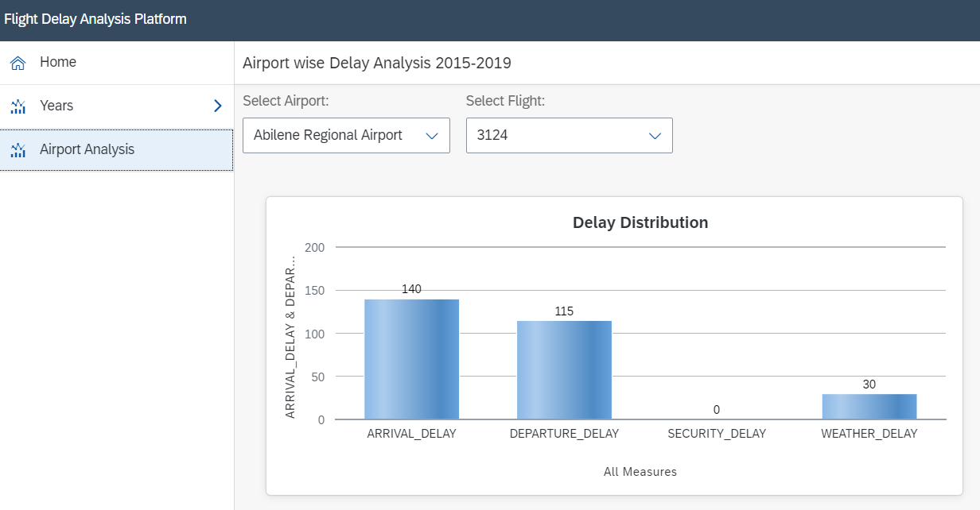

Slide 11
